Slide 1
WEEK 5 Great health for the
menopause and beyond!

Slide 2
This week
CH
The 5 core reasons for your symptoms
Oestrogen and collagen link/ hydration
Health after the Menopause – Bone/Heart Health
Hot Flushes
Listen to your body
How to move forwards

Slide 3
The 5 core health imbalances of the menopause
CH
Nutritional depletion caused by hormone change and cortisol release
Lack of Essential fatty acids
Impaired gut health
Liver impairment/ toxicity
Adrenal fatigue

Slide 4
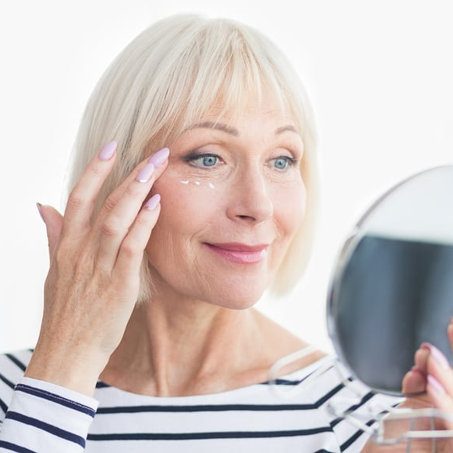
Oestrogen health links
CH
Oestrogen creates a loss of:
hydration for the skin, organs and vagina
bone density and collagen
good cholesterol and increase in the bad one
Collagen decline leads:
to weaker skin, tendons, ligaments
slower wound healing
‘Looser’ functionality in the gastro-intestinal tract
Sluggish digestive system
Prolapses
This is why it is so important to take the supplements
to support and replenish these areas

Slide 5
Hot Flushes
CH
The most mysterious of the symptoms to explain but I believe they are an accumulation of the 5 core health imbalances during the menopause transition
You lose temperature control with adrenal fatigue, and this allows hot flushes
Everything you have done over the last 4 weeks builds to combating hot flushes
Take a Vitamin C with Bioflavonoids (from citrus fruit) these are mildly oestrogenic
Eat Phyto-estrogens (in Eating for the Perimenopause and beyond)
Blossom cream was designed to help ease Hot Flashes and Night Sweats

Slide 6
Under active thyroid
CH
Due to a lack of iodine – this can be taken as a topical supplement on the skin, but seek professional advice as too much can be detrimental
Liver detox, cleanse and then get a new test as a clogged liver can give a false thyroid reading
Avoid a small group of foods that inhibits iodine uptake, main one is soya
Add seaweed and selenium into your diet
Eat Phyto-estrogens (in Eating for the Perimenopause and beyond)
Exercise – quality , variety and listening to your body, and relaxation!

Slide 7
Post menopause health - Supplements
CH
Post menopause health – the 2 main concerns and linked to decline of Oestrogen – Osteoporosis and Cardio vascular disease
Good Bone health - **Omega 3, ** Magnesium, ** Calcium, ** Vitamin C and D
Good Heart Health – **Omega 3, ** Magnesium , ** B complex, ** Vitamins D and E
Also to consider in the future – upping the dosages/age appropriate
Changing to a 50+ multivitamin
Add in Bromelain, Chondrotin, Glucosamine for bone health
Add in Vitamin K, CoEnzyme Q10, Garlic for heart health
** must have

Slide 8
Post menopause health – Supplements 2
CH
‘Menopause’ labelled products – contain Phytoestrogens. Only appropriate if you are flushing daily and periods very erratic or finished
‘Combination’ supplements – may have one detrimental component in, all of the formula needs to be checked
My supplements are ‘building’ blocks of your body chemistry – i.e. the actual nutrients the body is missing and /or singular supplements
You can take individually and note the changes/side effects

Slide 10
Let’s see your progress

Slide 11
The value of taking the time to watch these videos
What will you take away and embrace for your brighter menopausal future?
What difference has this time made for you?
What’s your one greatest change/ light bulb moment?
The skills and insights from this experience
can be used again and again throughout your life

Slide 12
Moving Forwards
There are 3 ways your life path can go at the end of this series:
Things go back to the way they were and you forget all of this
You think ‘that’s done, what’s the next thing I need?’
You embrace your insights from this and use again, especially
when the weather changes, symptoms change or life gets
more difficult.
You have the knowledge now , keep these slides and revisit.

Slide 13
Having a 1 to 1 with me
If you would like to discuss more indepth what is going on for you in your health and menopause
Want to explore how understanding your health and emotion patterns affect you and how they can be resolved
Resolve more complex health issues
A 30% lifetime discount off a consultation!

Slide 14
Continuing your journey with me and your peers
Private facebook group where we can continue the conversation
I’ll be able to answer questions, post more information
You’ll have the support of your peer group
Monthly zoom chat session
Just a small monthly fee – Read more here

Slide 16
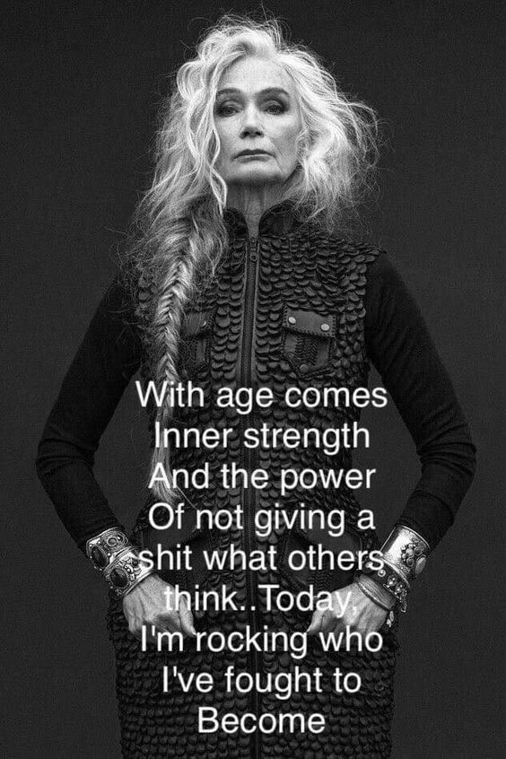
CH
“So many women I’ve talked to see menopause
as an ending. I’ve discovered this is your moment to reinvent yourself after years of focusing on the needs of everyone else. It’s your opportunity to get clear about what matters to you and then to pursue that with all of your , time and talent.”
Oprah Winfrey
energy

Slide 17
I hope you’ve had a
wonderful experience
Please let me know here
CH

